Slide 1
FRAMES 1.3
FRAMES SOFTWARE
What is FRAMES?
The Framework for Risk Analysis in Multimedia Environmental Systems (FRAMES) is a software platform where users plug and play different environmental modules. FRAMES is an open-architecture, object-oriented system. This software platform aids the user in constructing a Conceptual Site Model that is real-world based. Further, the software allows the user to choose the most appropriate codes to solve simulation requirements and presents graphical packages for analyzing results.
What is the purpose of FRAMES?
The purpose of FRAMES is to assist users in developing environmental scenarios and to provide options to select the most appropriate computer codes to conduct human and environmental risk management analyses. FRAMES accomplishes this purpose by allowing users to link codes under one integrated system using standard data file specifications; build a conceptual site model (CSM) using module icons in a Windows-based interface to represent the flow of contamination through the environment; conduct sensitivity and uncertainty analyses on the assessments; and view analyses results using graphical and text viewers.
Overview

Slide 2
SOFTWARE REQUIREMENTS
Requirements
Windows 95 or higher.
Installing FRAMES 1.3
Insert the install CD and select the Run option from the Start menu
In the Run screen, click the browse button and select the CD drive and double click on setup.exe
Follow the Windows Setup prompts provided to complete installation.
Installing other software packages
After completing the FRAMES setup install, other software packages ran within FRAMES (I.e., MEPAS) can be installed. It is important that these additional software packages be installed into the FRAMES folder; it will not run correctly if saved in a different folder other than FRAMES.
File locations
All files relating to the FRAMES installation must be installed in the FRAMES folder. FRAMES will run most accurately when there are no spaces in the folder names. It is recommended that FRAMES be installed to the location C:\FRAMES.
Overview

Slide 3

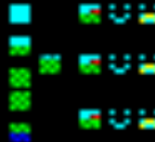
OPENING FRAMES
Opening FRAMES after installation
There are two ways of opening the FRAMES software.
After installing the FRAMES software, a shortcut labeled “FRAMES 1.3” will be placed on your desktop.Open FRAMES by double clicking on the shortcut (Figure 1.1)
Open the file browser, such as Windows™ Explorer, and go to the folder in which FRAMES was installed (usually C:/FRAMES). Select the application fui.exe.
Figure 1.1 FRAMES 1.3 desktop shortcut
Overview

Slide 4
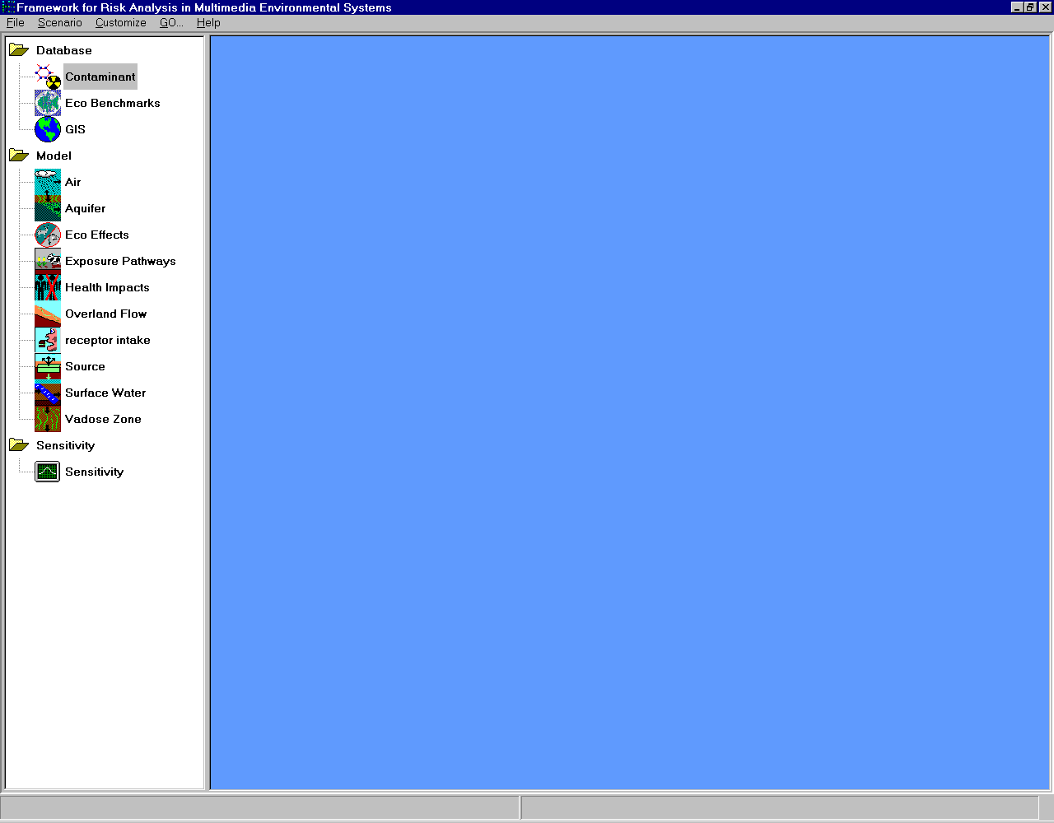
Interface Overview
INTERFACE OVERVIEW
Interface Overview
This is the main FRAMES 1.3 screen. General terms are labeled below.
Menubar
Icons. Each represents a module to be linked to model the site.
Conceptual Site Model (CSM). Also known as the “main screen,” this shows the flow of contamination across the site being modeled through the linked icons. The CSM defines the “real world” problem in a simplified way to conduct analysis.
Toolbar
Overview

Slide 5
Contacts
CONTACTS
For more information, contact:
Gariann Gelston
P.O. Box 999, MSIN K6-80
Richland, WA 99352
Voice: (509) 376-6104
Fax: (509) 373-0335
Email: Gariann.gelston@pnl.gov
Pacific Northwest National Laboratory is operated by Battelle for the U.S. Department of Energy

Slide 6
TABLE OF CONTENTS
FRAMES 1.3 Tutorial
This is a step-by-step tutorial that allows the user to become familiar with FRAMES and its functionality. It will lead the user through the complete process of building a scenario case within FRAMES, and will also provide the user with a comprehensive understanding of FRAMES, the software itself.
FRAMES 1.3 Reference Section
The reference section gives detailed and concise explanations regarding specific topics within FRAMES. This includes an overview of basic terminology used within FRAMES, how to open and save a *.gid file, understanding of the lighting system, etc. Refer to this section for general directions and explanations regarding FRAMES and its functionality.
For More Information
Phone numbers and e-mail addresses are available for further information or questioning.
Table of Contents

